Slide 1

Presentation
on
Lyrics Player
coded in java
Prepared By: Baljeet Singh & Jaswant Singh

Slide 2
Project Objective
To provide single fully functional GUI mp3 player
To provide full unicode lyrics support built in to the player (not available before in any other player)

Slide 3
Introduction
Core Java GUI Project (lyrics player)
fully functional mp3 player with lyrics module built in
ability to create playlists
ability to search songs lyrics

Slide 4
Technology Used
Java (J2SE) : Features:
Simple & Secure
Portable
Object-oriented
Robust
Platform Independent
Dynamic

Slide 5
Technology Used (contd.)
MySQL : Features:
Simple & Secure
Portable
Open Source
Free
Cross Platform
Unicode Support
SQL Compatibility

Slide 6
Requirements to Run
You must have jre installed to run the lyrics player
You must have Arial Unicode MS font installed to view the lyrics

Slide 7
Project Modules
Two Modules: lyrics window and mp3 player window
Lyrics window: where you will see the lyrics
mp3 player window: where you can see the song playing

Slide 8
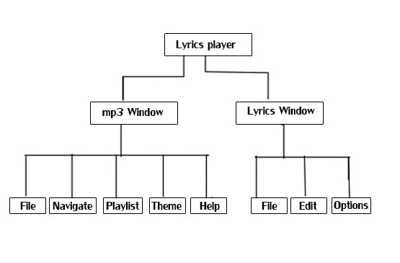
Project Modules(Contd.)

Slide 9
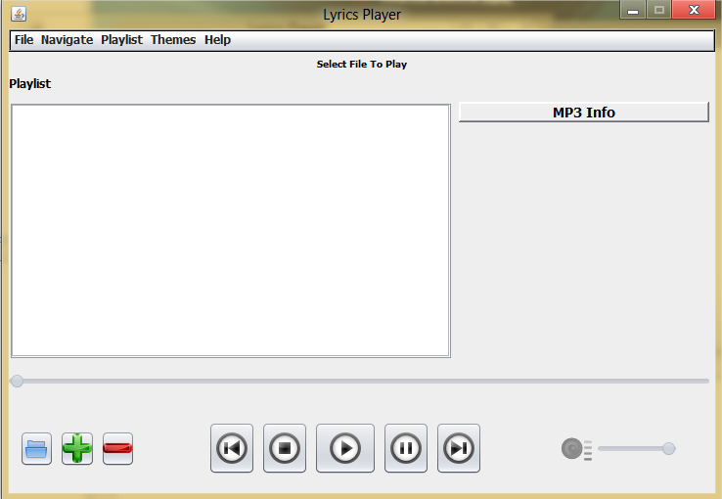
mp3 Window

Slide 10
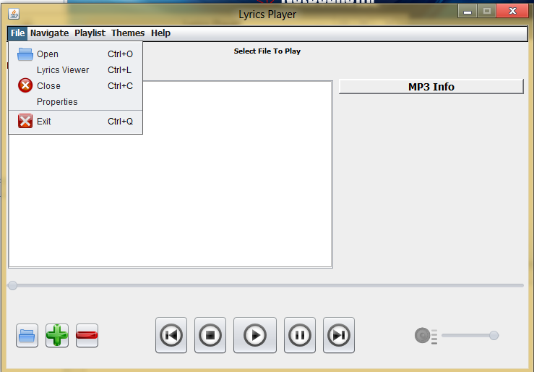
mp3 Window – file menu

Slide 11
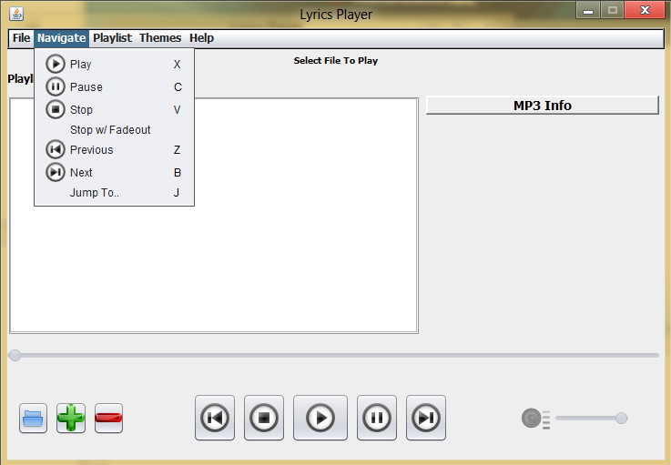
mp3 Window – navigate menu

Slide 12
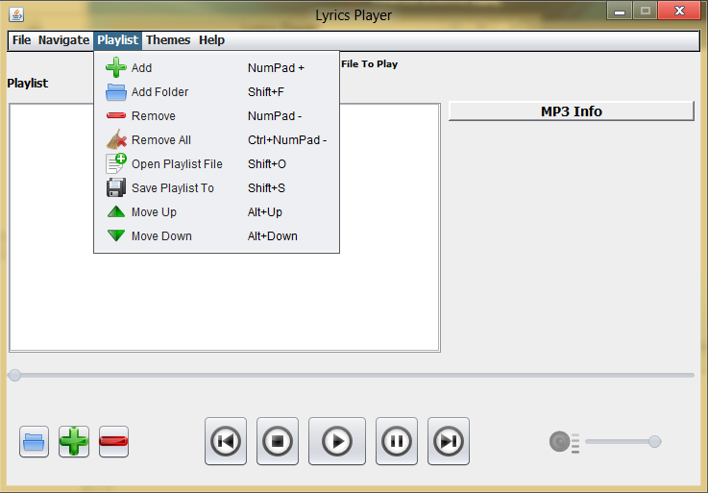
mp3 window-playlist menu

Slide 13
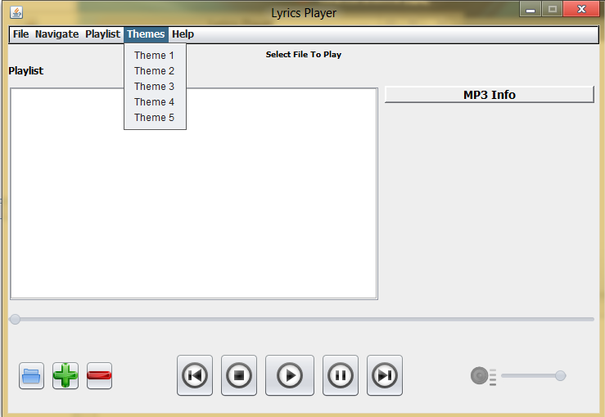
mp3 window-theme menu

Slide 14

mp3 window-buttons

Slide 15
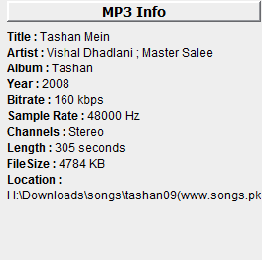
mp3 window-mp3 info

Slide 16
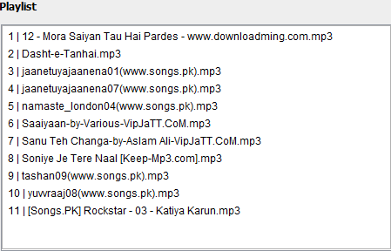
mp3 window-playlist view

Slide 17
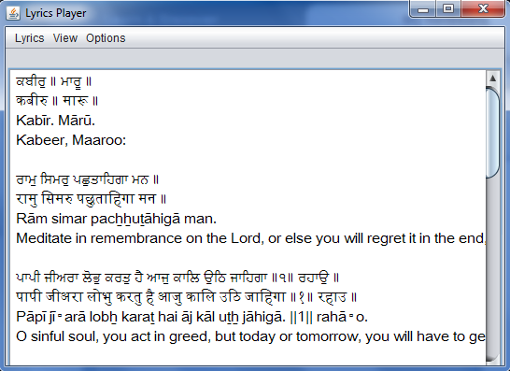
Lyrics Viewer

Slide 18
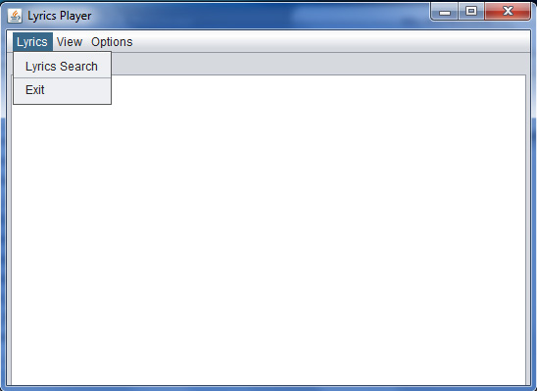
Lyrics Viewer- lyrics menu

Slide 19
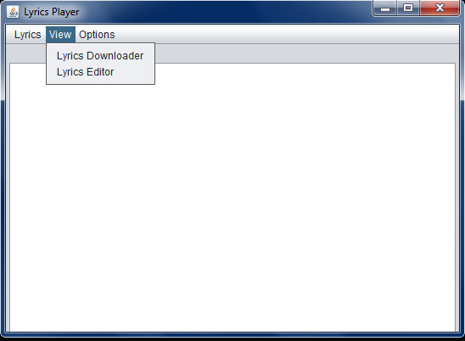
Lyrics Viewer- view menu

Slide 20
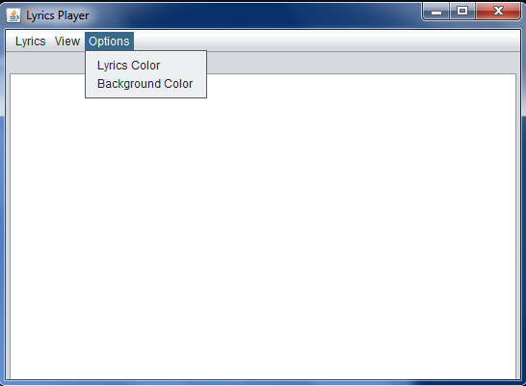
Lyrics Viewer- options menu

Slide 21
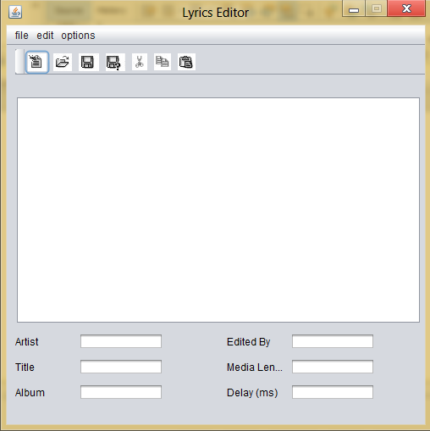
Lyrics Editor

Slide 22
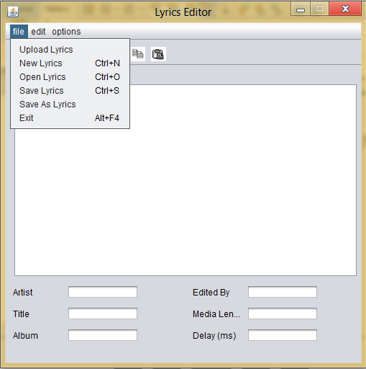
Lyrics Editor – File Menu

Slide 23
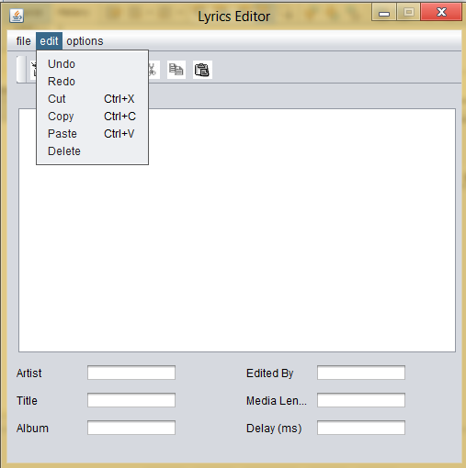
Lyrics Editor – edit menu

Slide 24
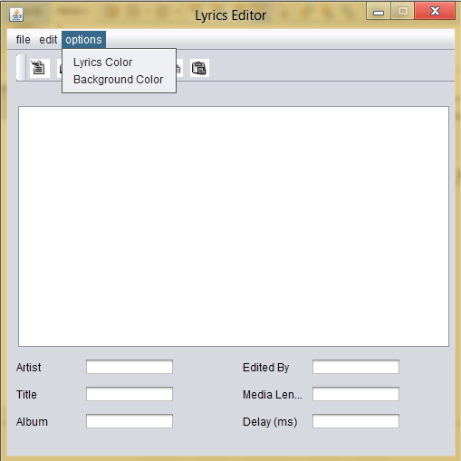
Lyrics Editor – options menu

Slide 25
Features
Fully functional mp3 player and fully functional Unicode lyrics player built in to the lyrics player.
Lyrics window can play lyrics in any language.
mp3 window can play any mp3 format like mp3 layer 1,2,3.
Can run on any system with jre installed.

Slide 26
Limitations
No timing controls for lyrics window
Not so appealing looks

Slide 27
Future Strategies
To add timing control for lyrics.
To make the look of player more appealing.

Slide 28
Conclusion
Thus this product provides the complete solution for an mp3 player & an lyrics player in the single software product and thus solves our purpose of making that software product.

Slide 29
Now let's have a look at the project

